Slide 1
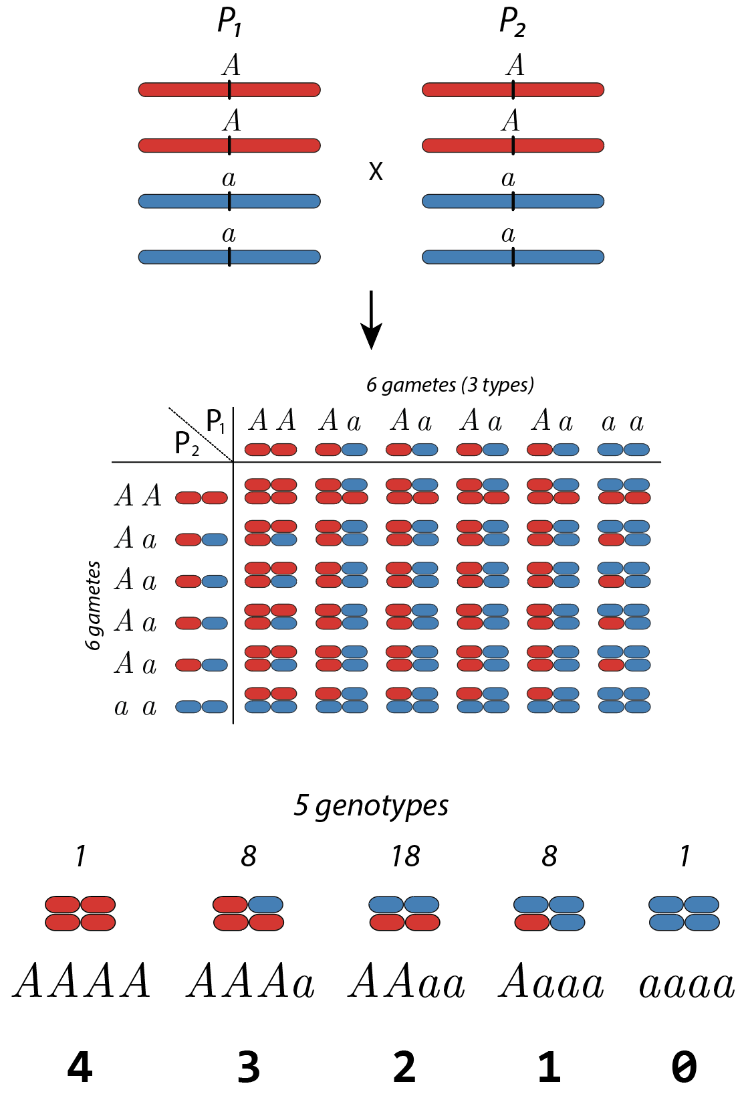
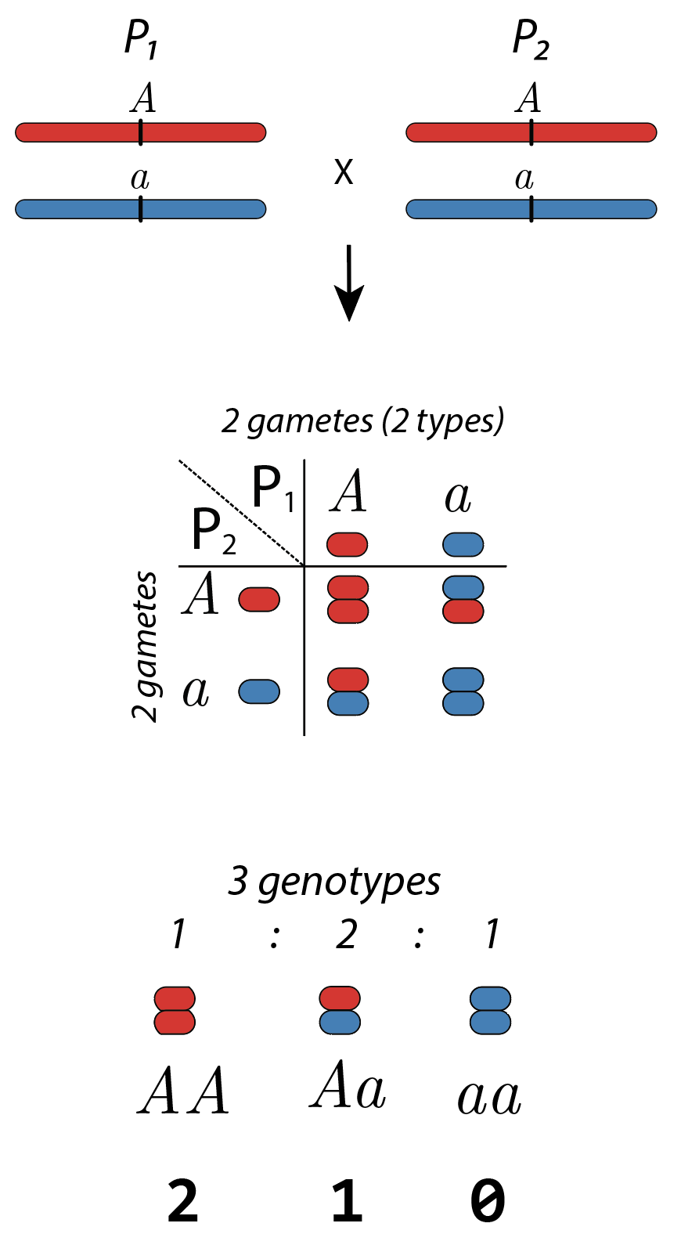
Segregation in polyploids
Diploid
Tetraploid

Slide 2
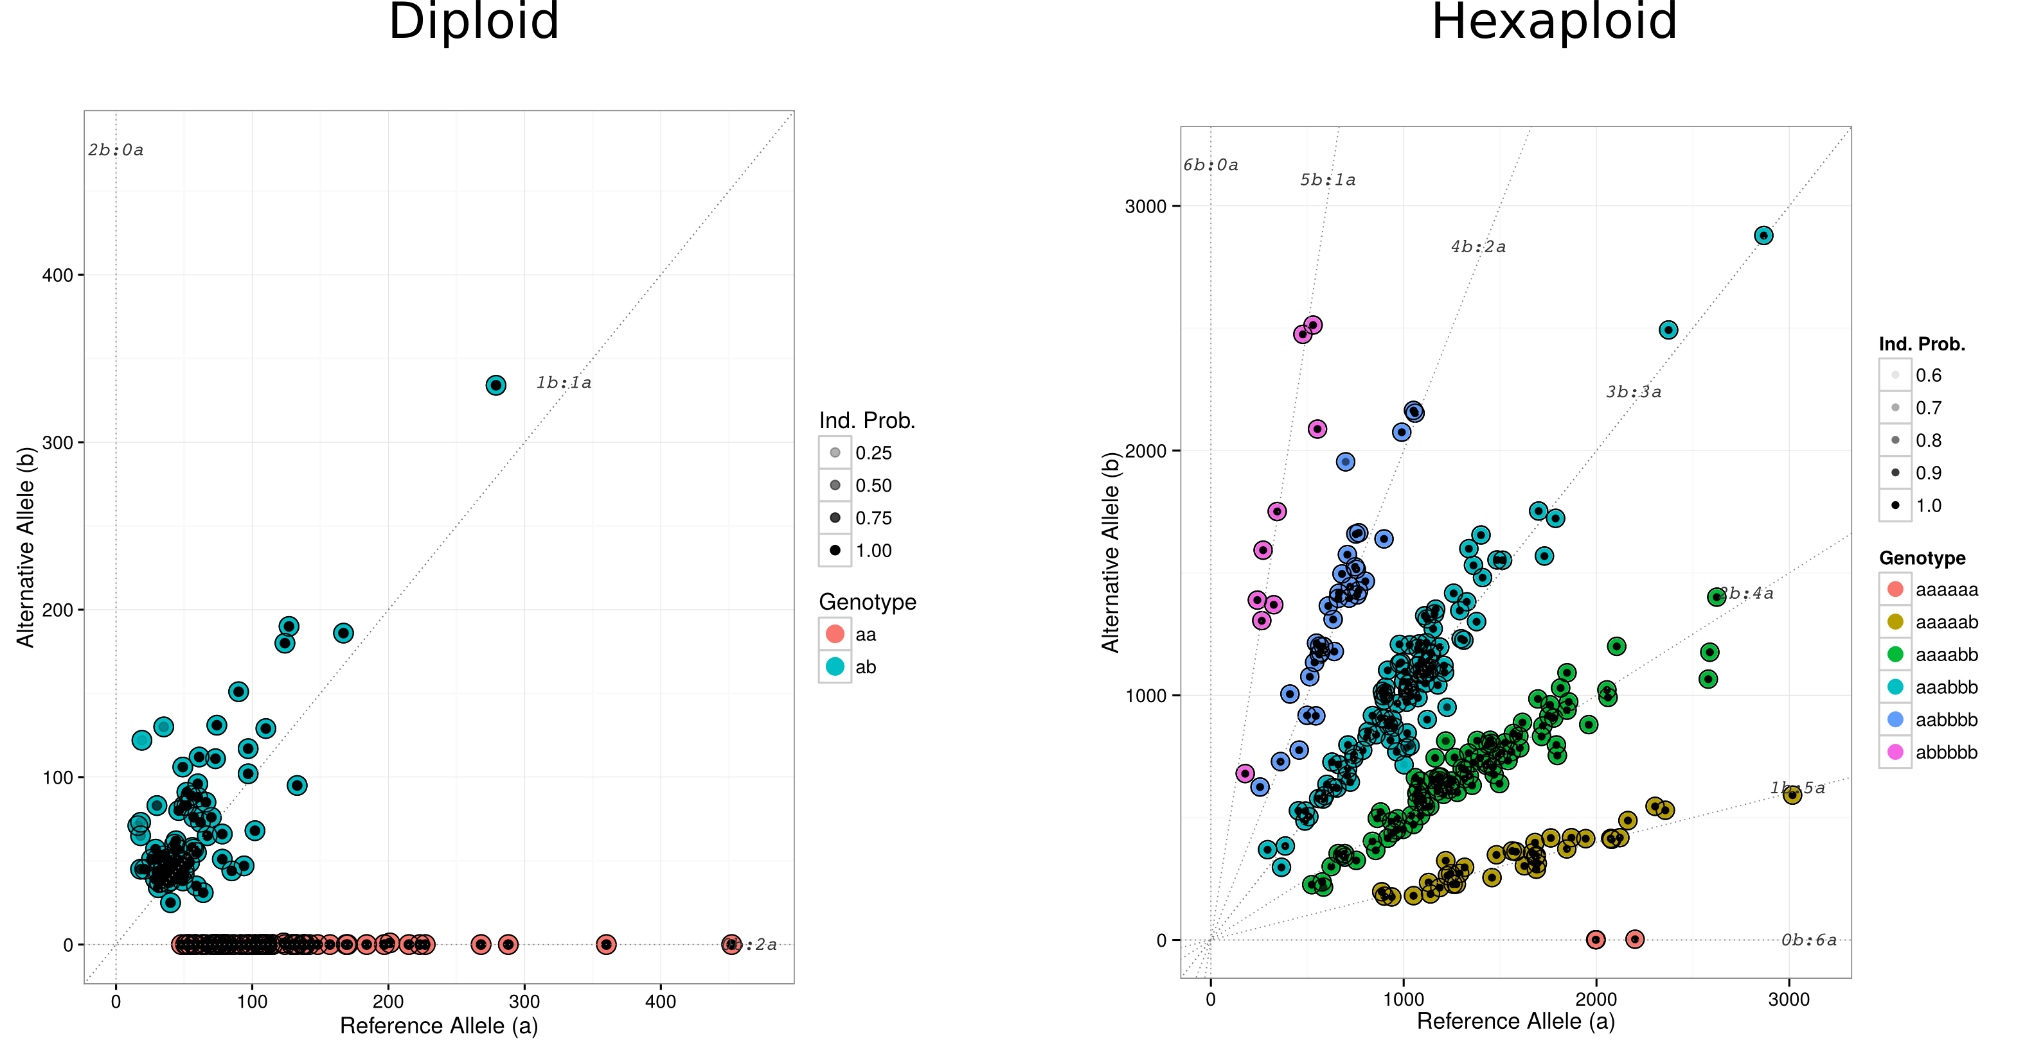
Genotyping calling in sweeetpotato
6
5
4
1
3
2
1
0
0

Slide 3
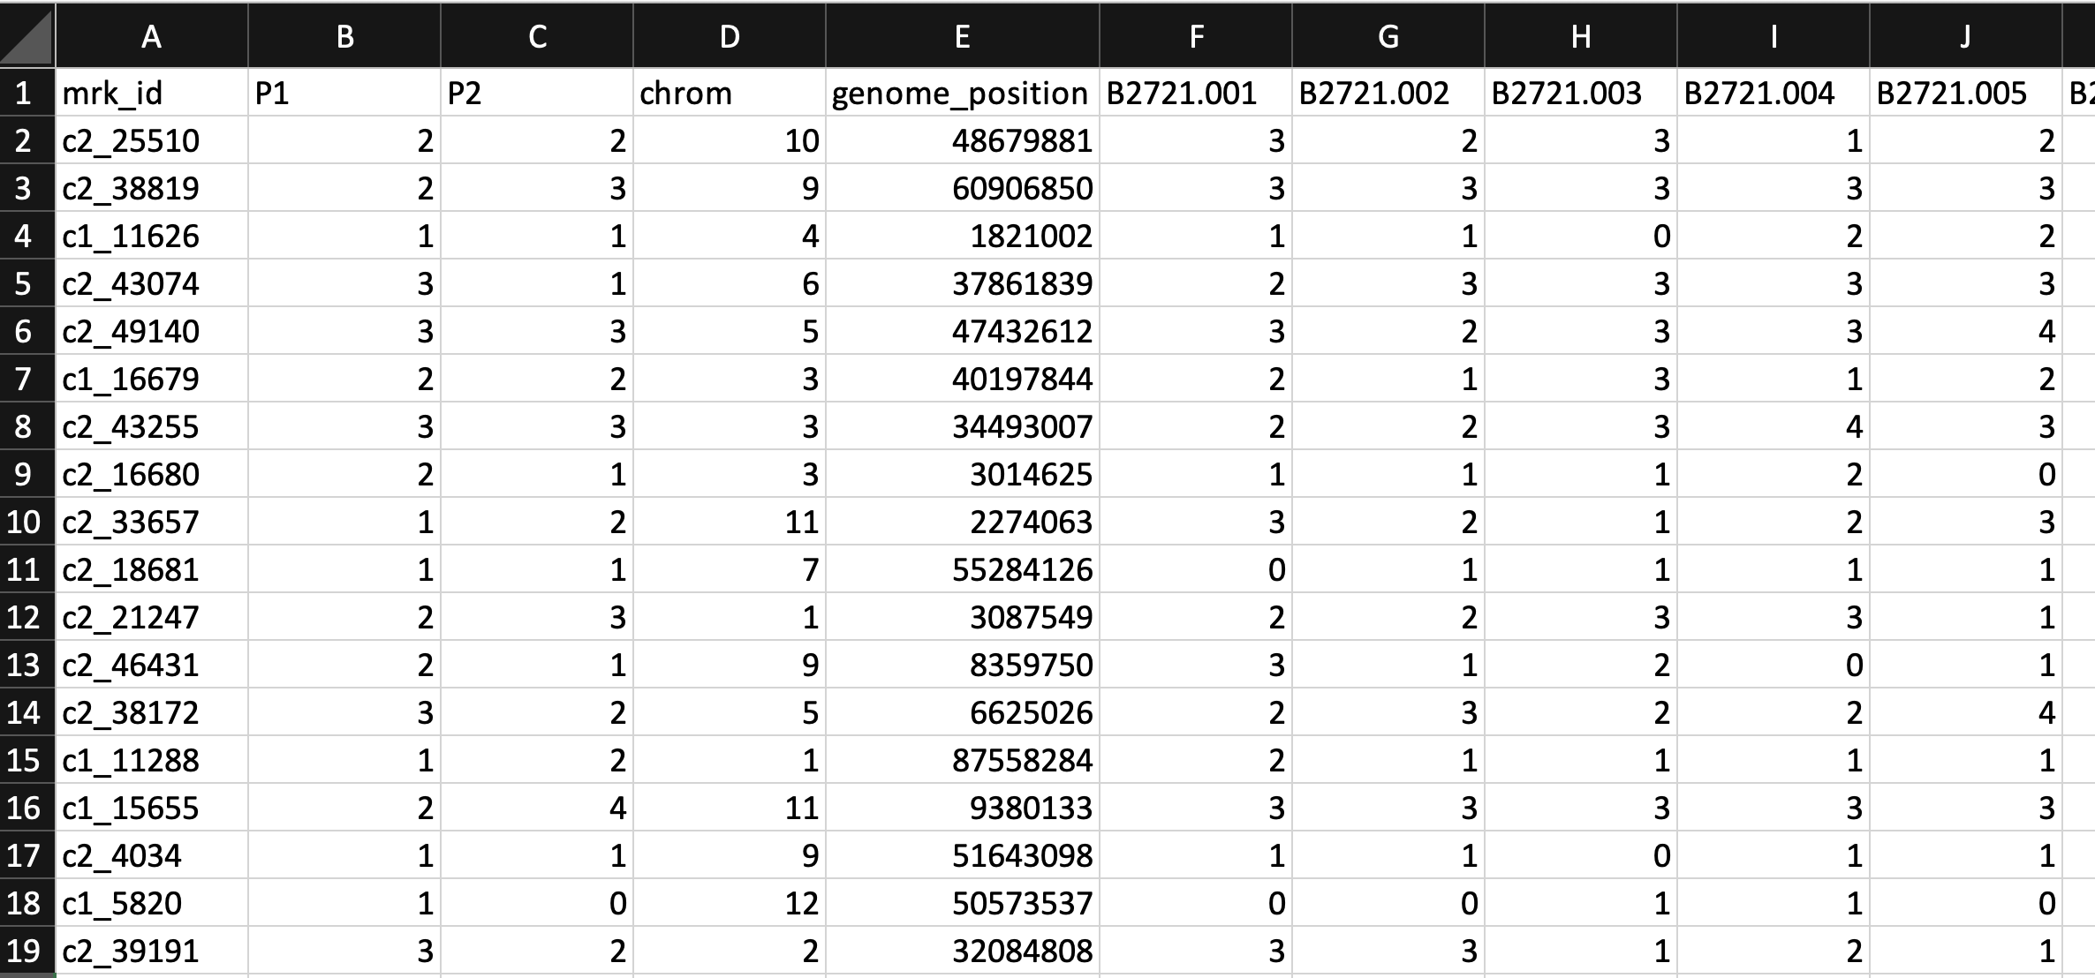
Potato data – doses from 0 to 4
Atlantic
x
B1829-5
Offspring
…

Slide 4
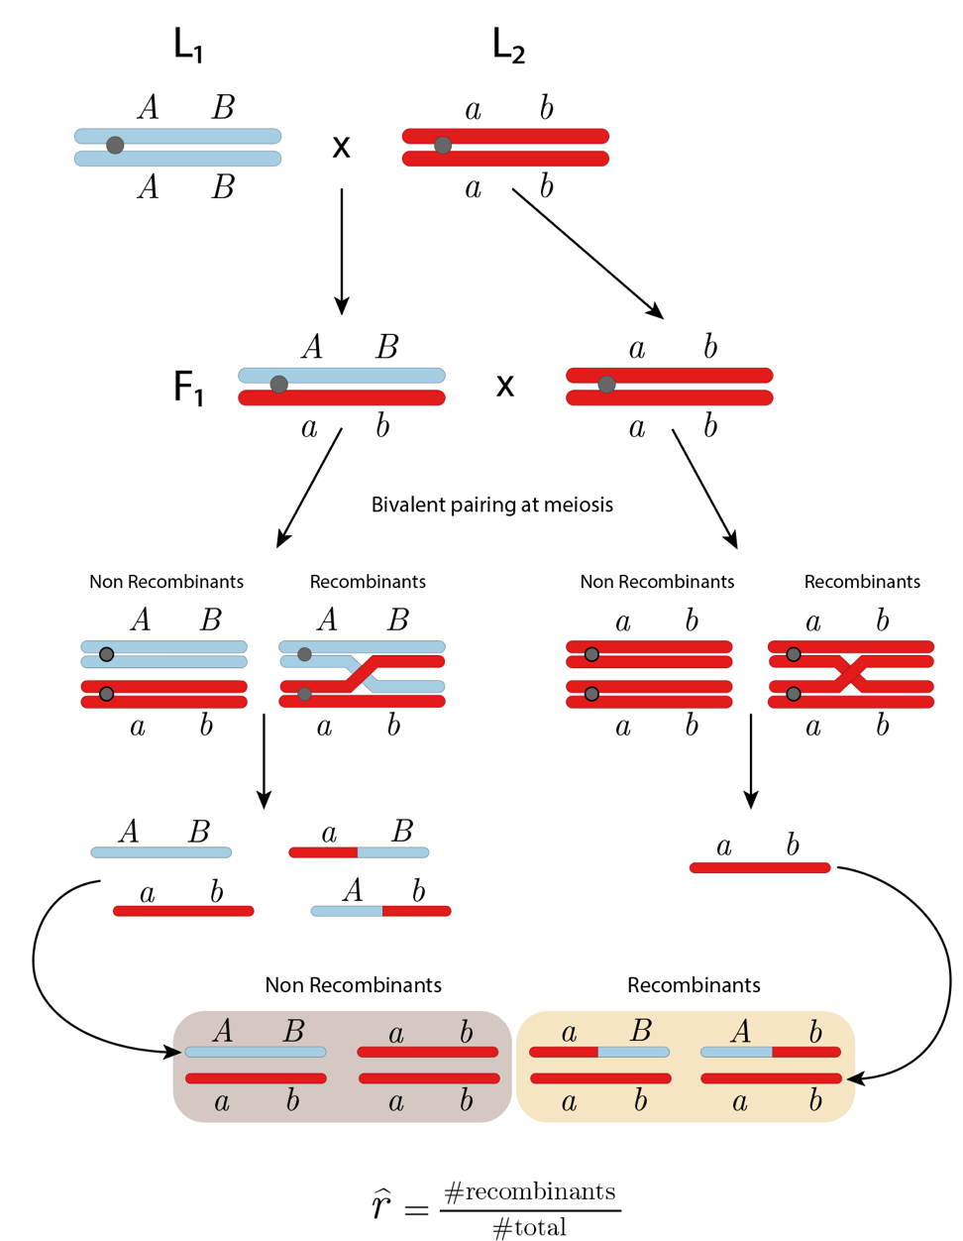
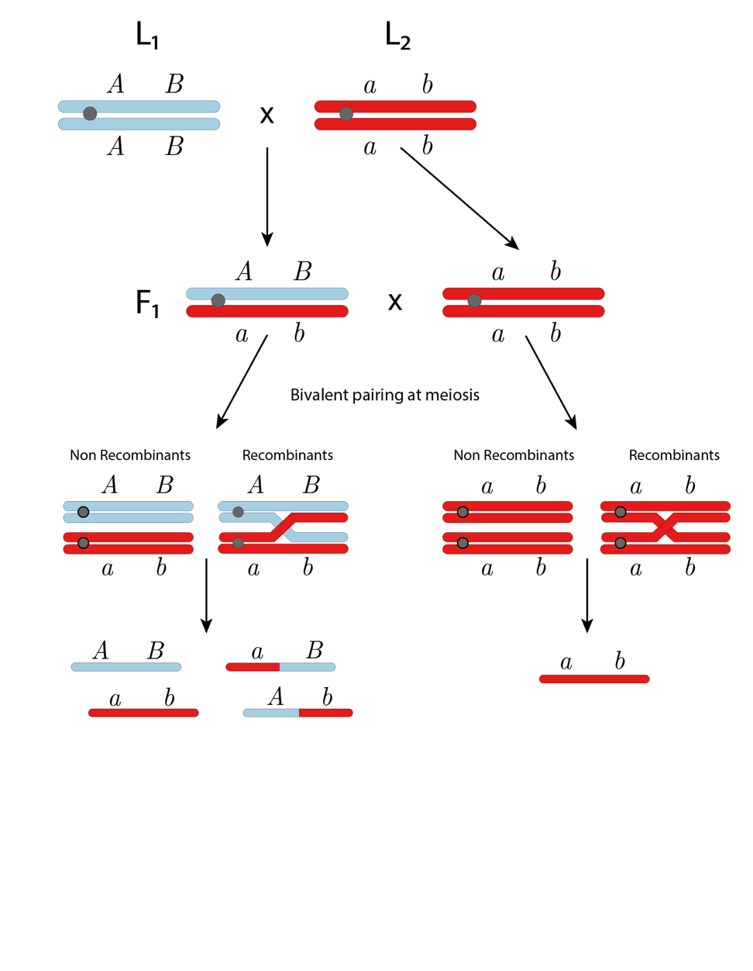
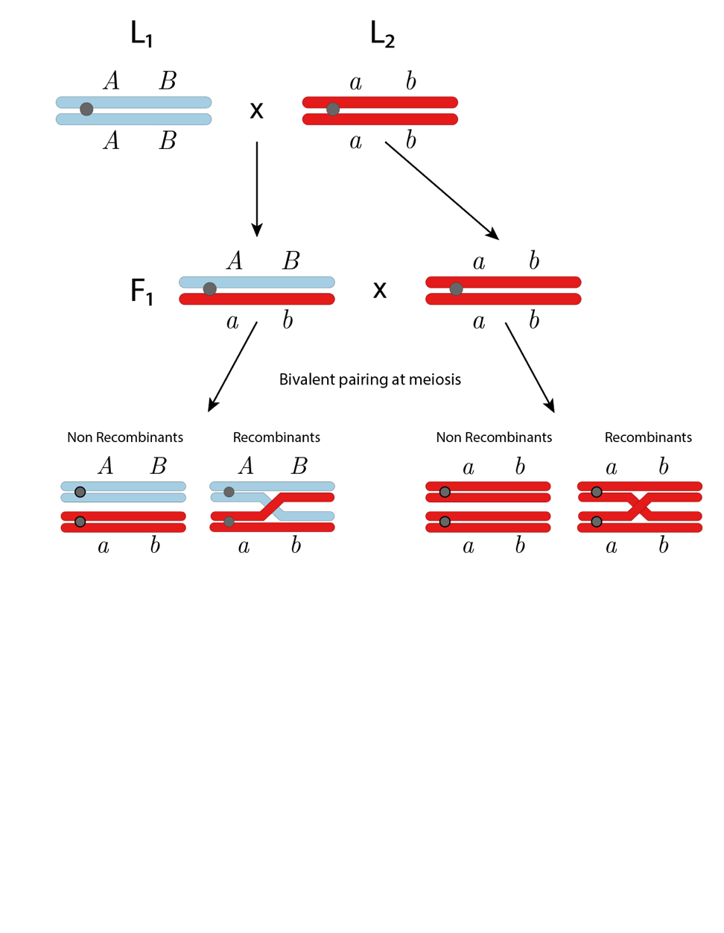
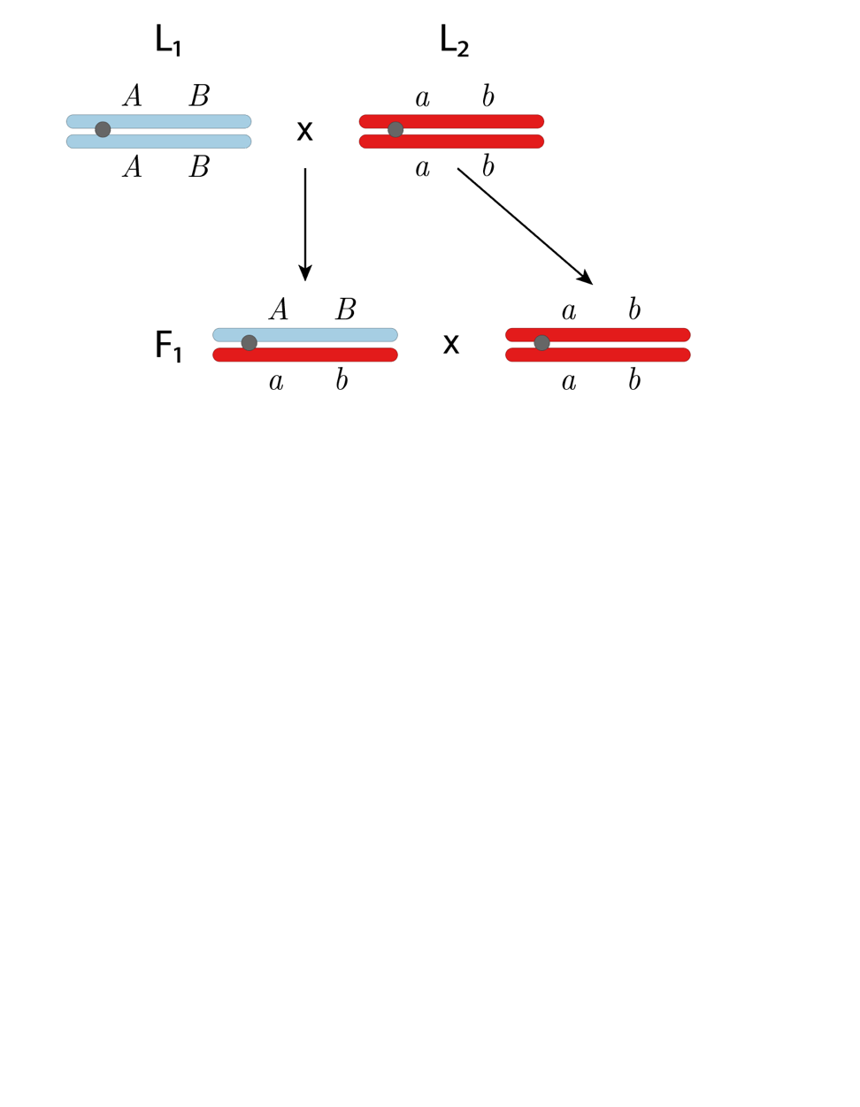
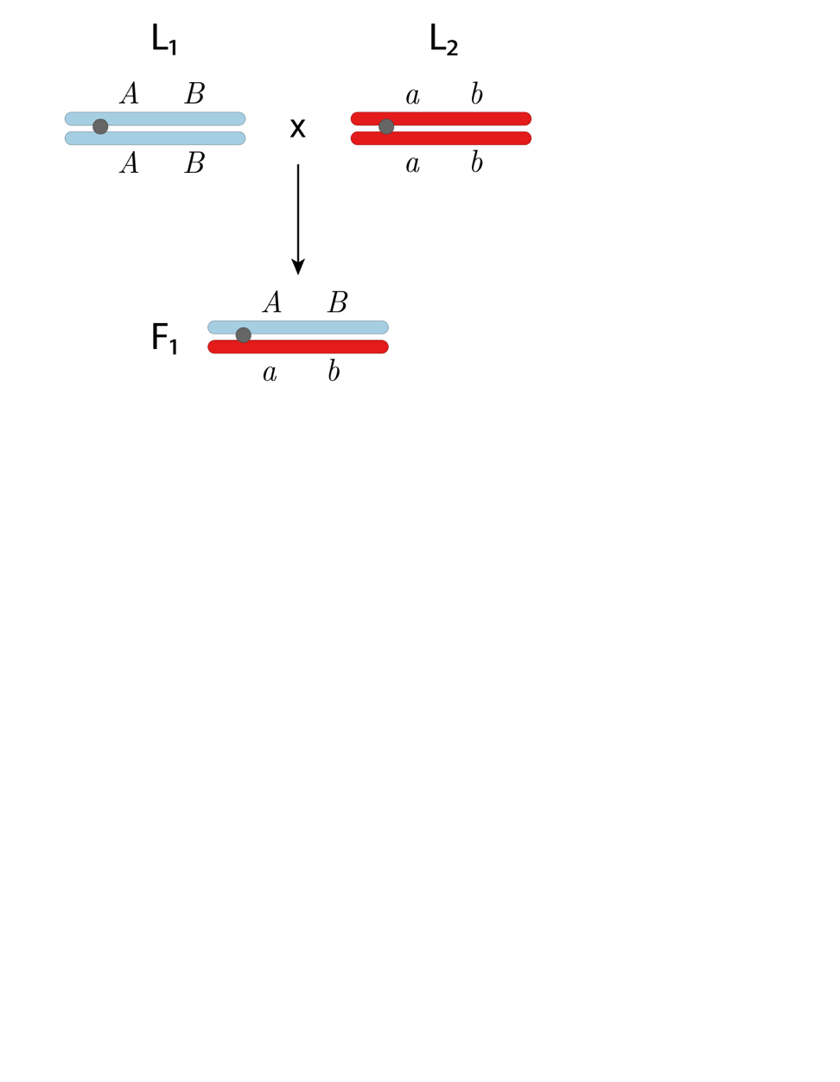
Recombination fraction in diploids derived from inbred lines

Slide 5
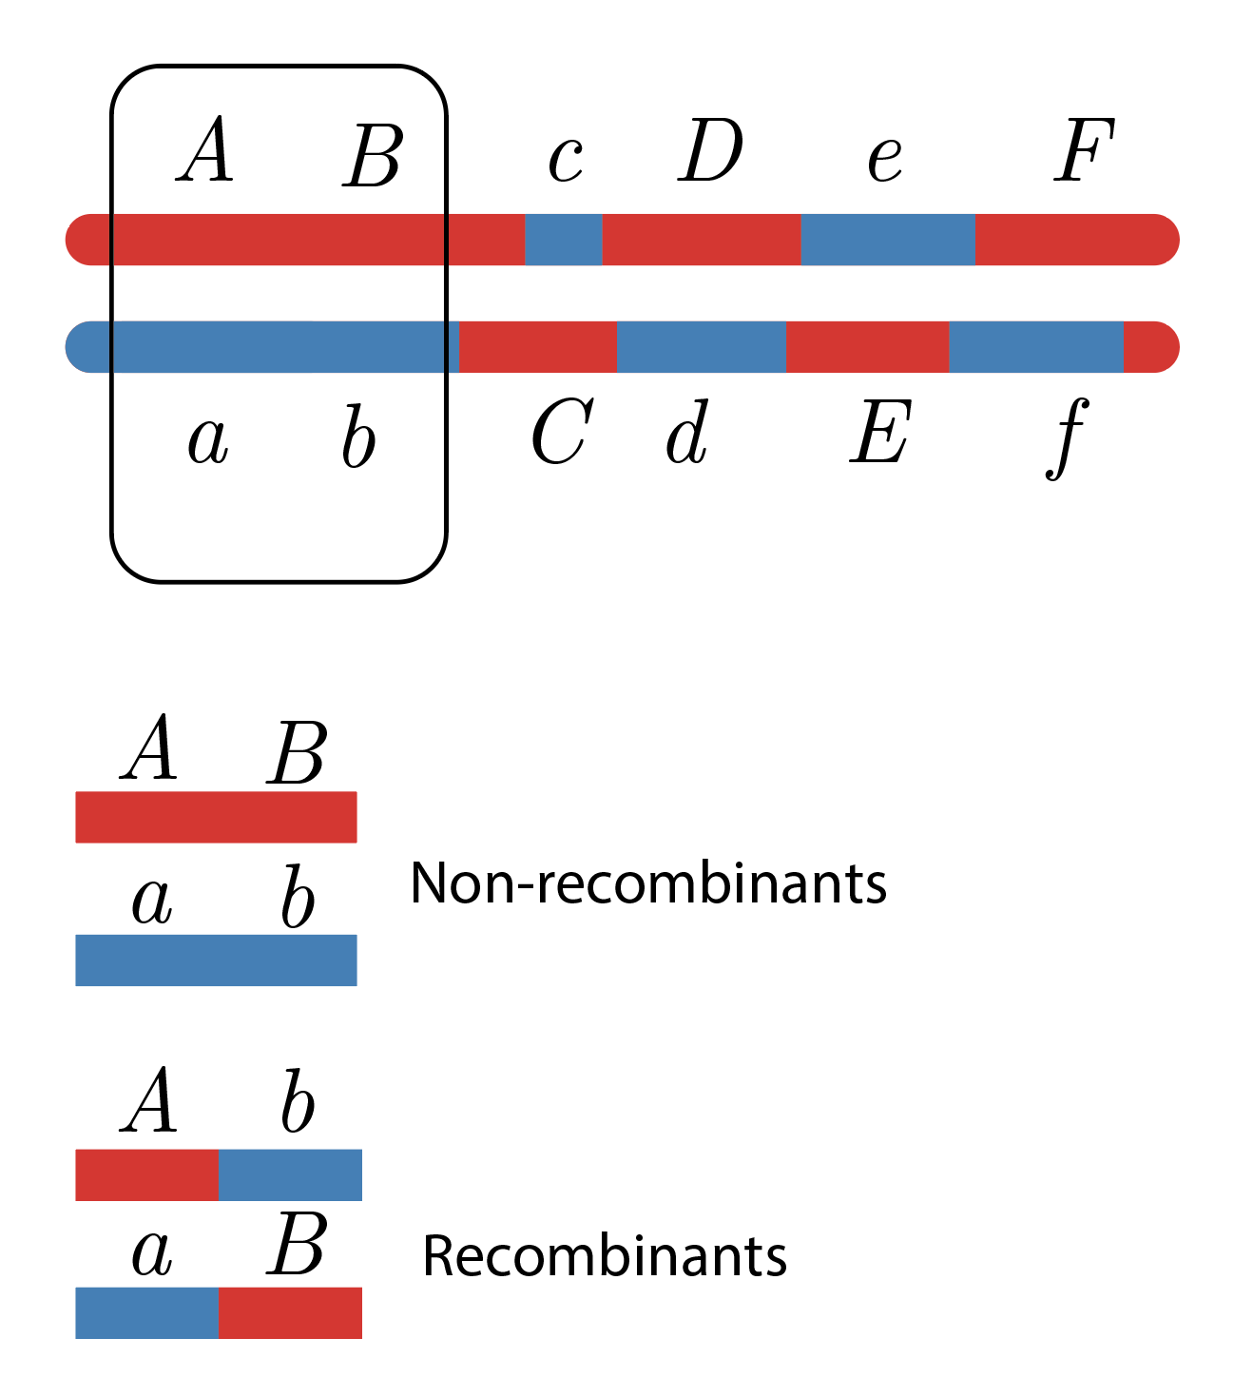
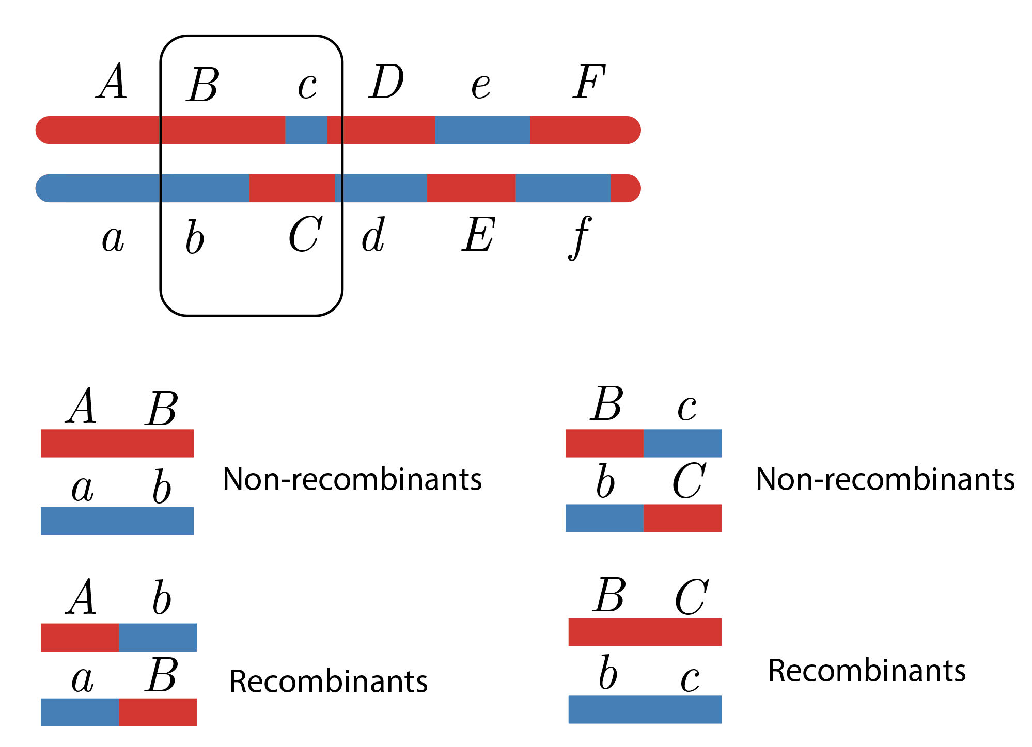
Phasing in outcrossing species - background

Slide 6
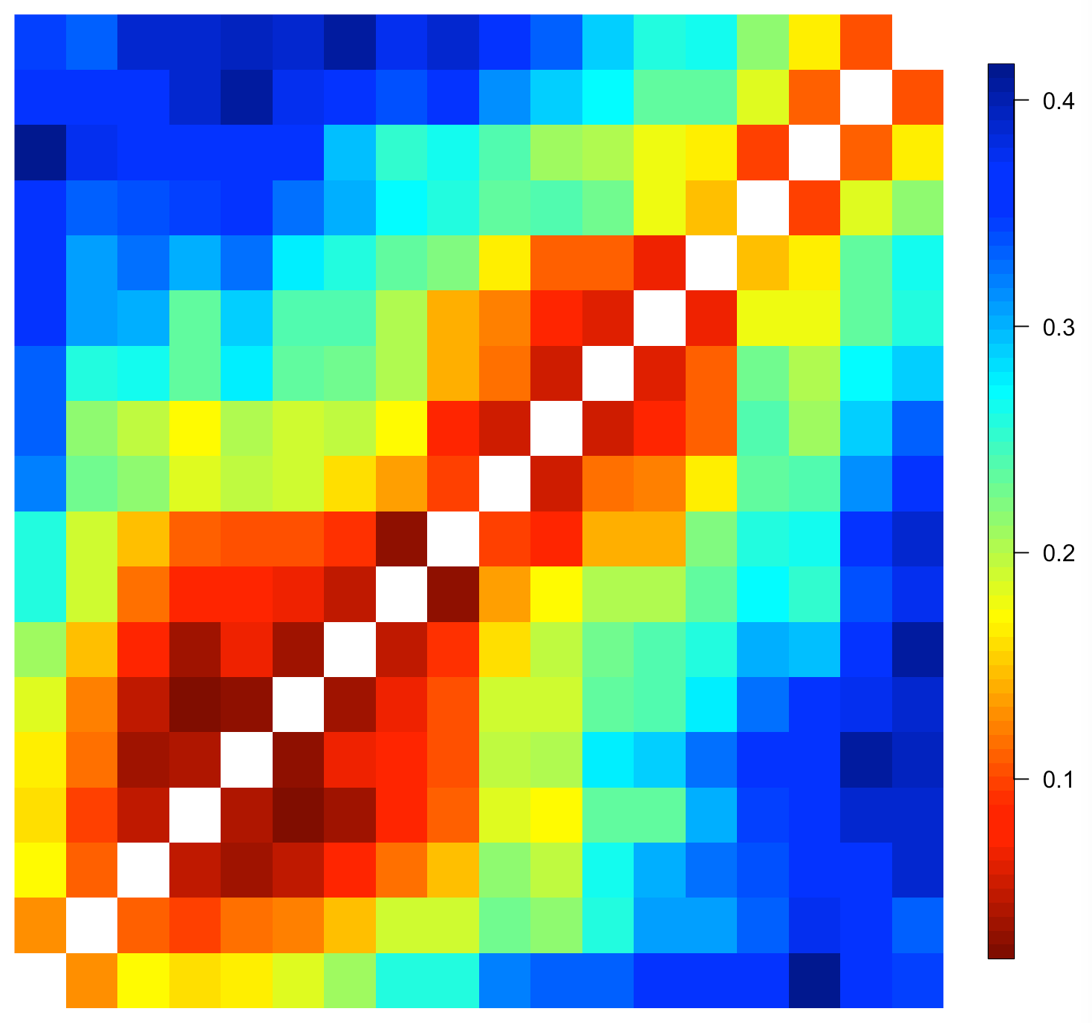
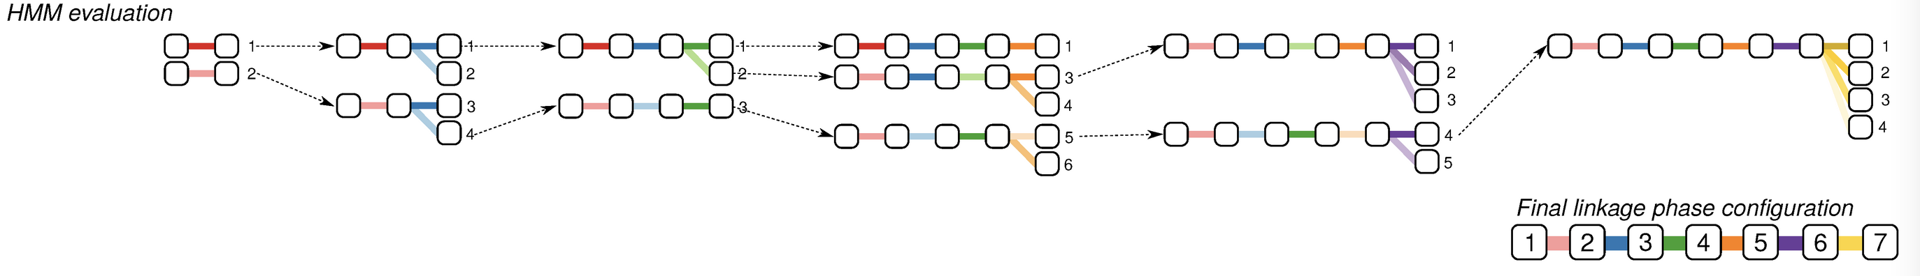
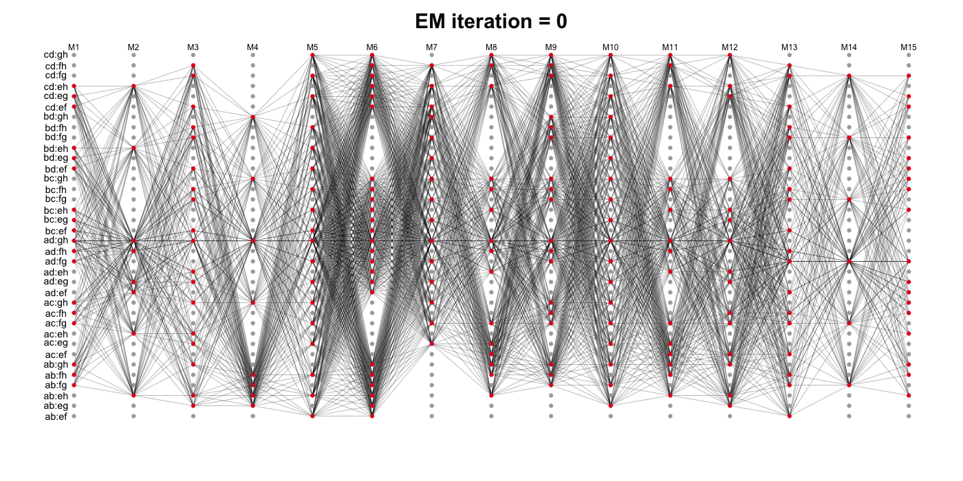
Phasing algorithm

Slide 7
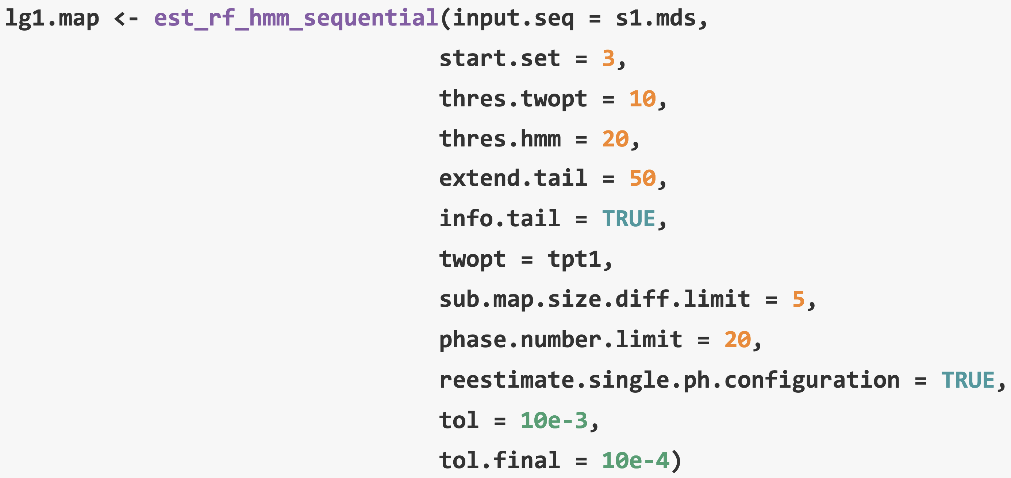
Phasing and re-estimating map

Slide 8
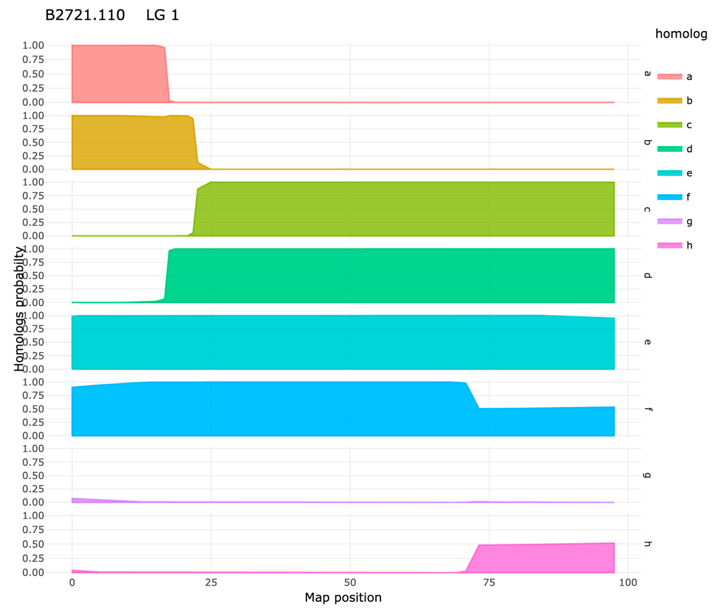
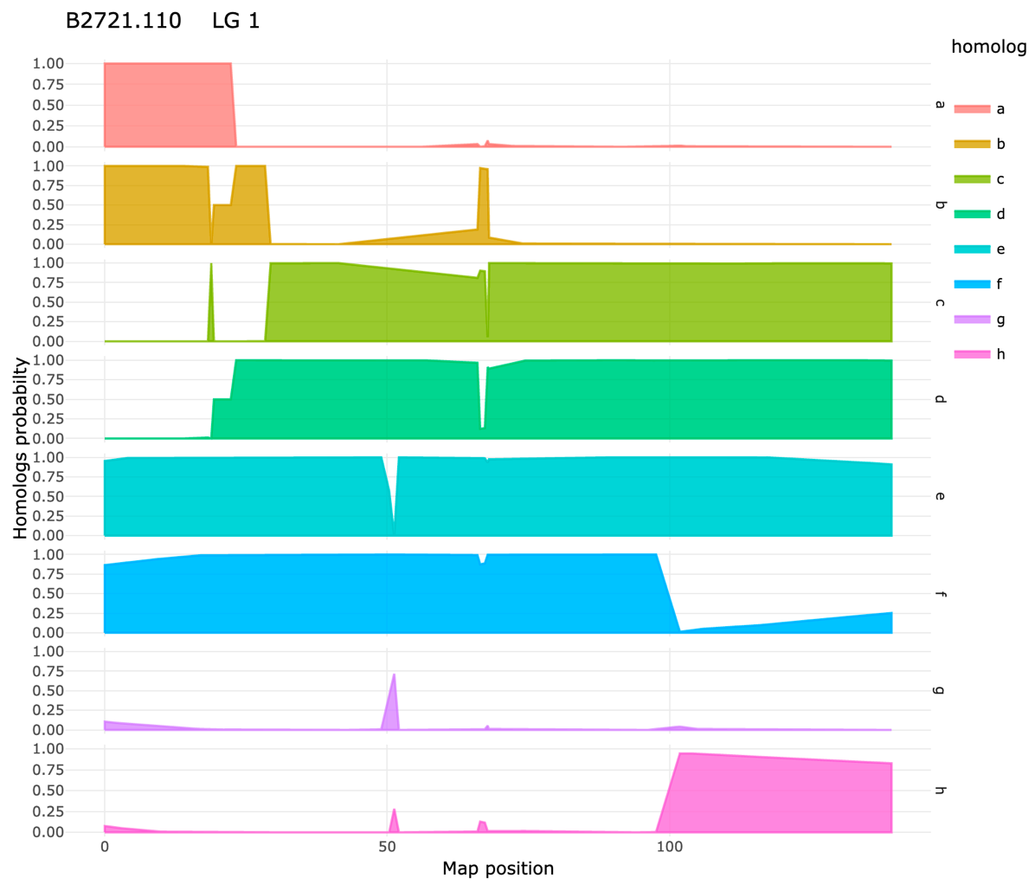
Probabilistic haplotype reconstruction
When assuming a prior probability distribution of the genotypes, multilocus strategies can improve the quality of the inferred haplotypes
Tetraploid potato

Slide 9
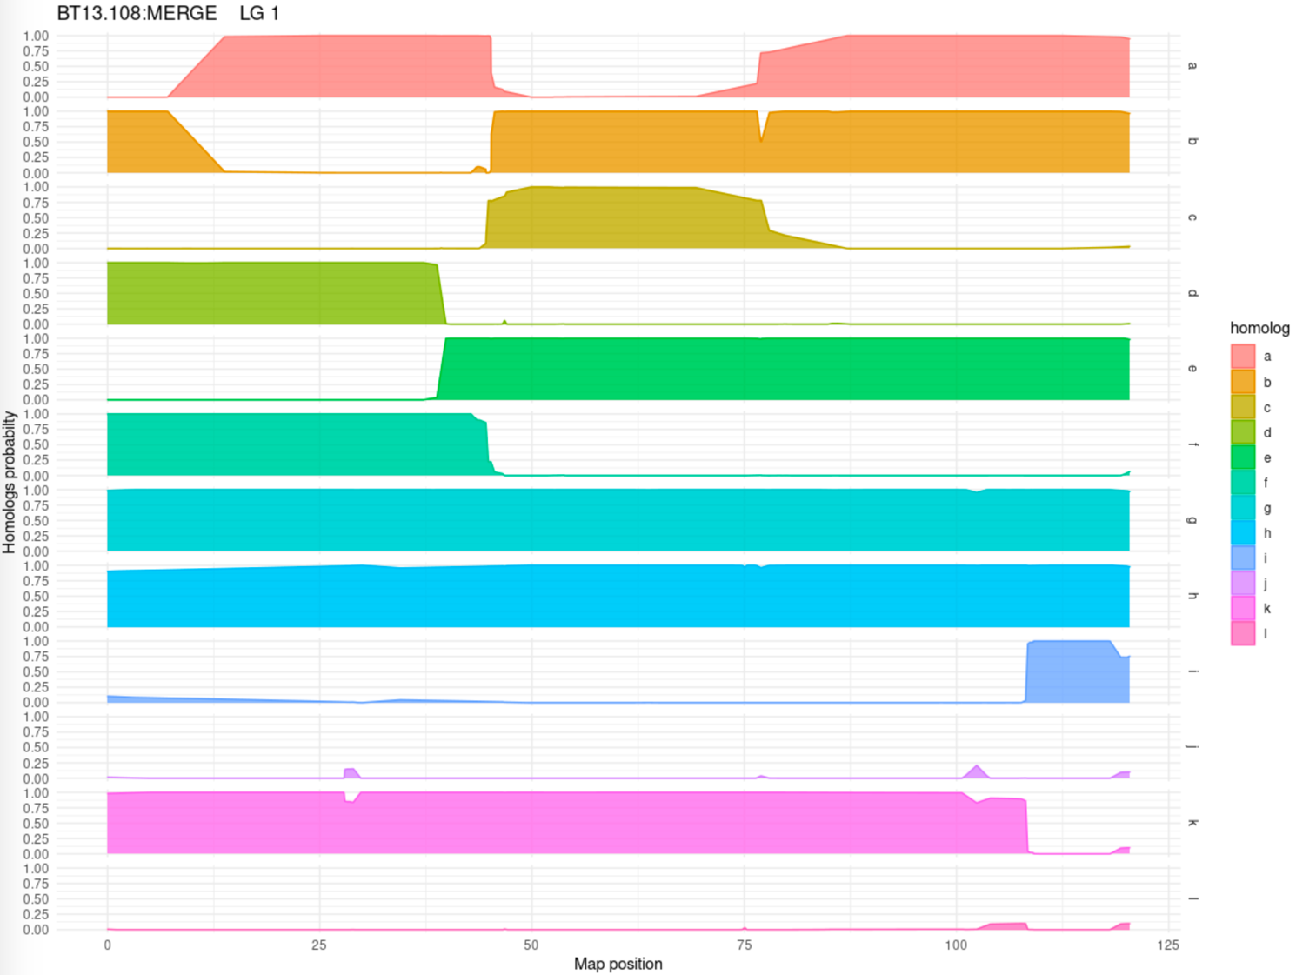
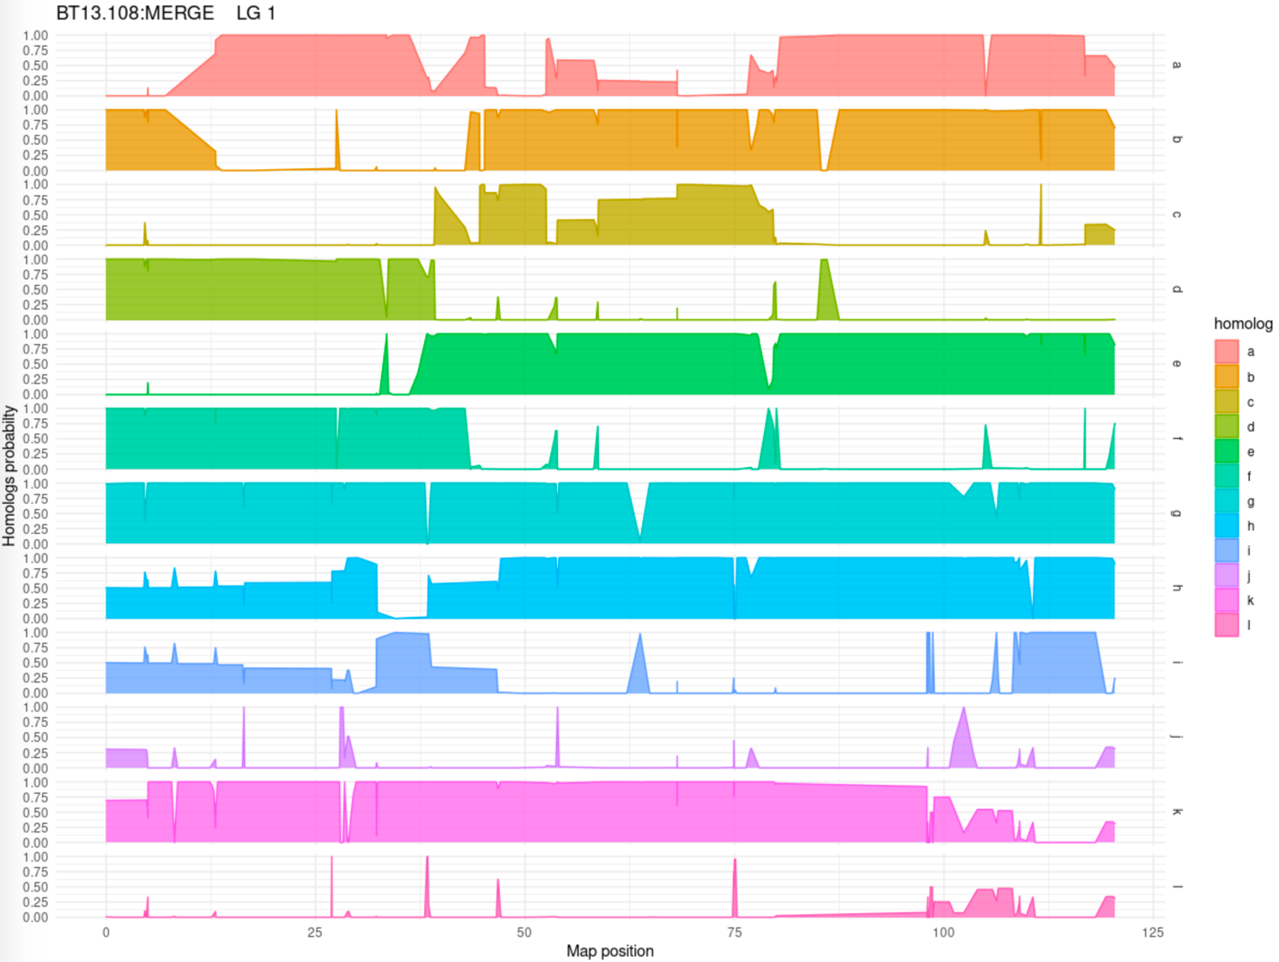
Probabilistic haplotype reconstruction
Hexaploid sweetpotato

